Slide 1
COT5615: Math for Intelligent Systems I
Anand Rangarajan
Lecture 2

Slide 2
Syllabus
Linear Algebra and Vector Spaces: vector spaces, matrix algebra, eigenvectors, singular value decomposition (SVD), norms, determinants, subspaces, geometric algebra
Hilbert Spaces: Elementary functional analysis
Constrained Optimization: convexity, Lagrange parameters, Karush-Kuhn-Tucker (KKT) conditions
Probability Theory: Functions of a random variable, maximum likelihood, distances between distributions, basic inference
[If time permits} Information Theory: Jensen's inequality, entropy, divergence measures

Slide 3
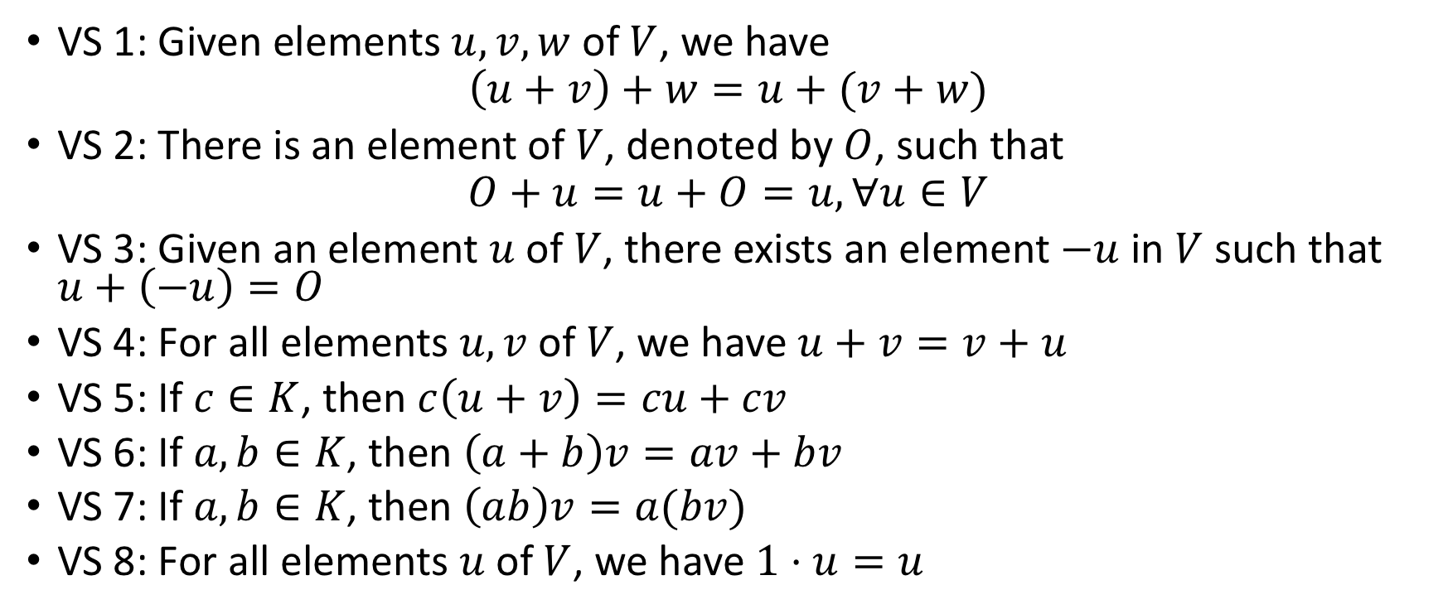
Vector spaces
VS 1: Given elements $u, v, w$ of $V$, we have
$$\left(u+v\right)+w=u+(v+w)$$
VS 2: There is an element of $V$, denoted by $O$, such that
$$O+u=u+O=u, ∀u∈V$$
VS 3: Given an element $u$ of $V$, there exists an element $−u$ in $V$ such that $u+\left(−u\right)=O$
VS 4: For all elements $u, v$ of $V$, we have $u+v=v+u$
VS 5: If $c∈K$, then $c\left(u+v\right)=cu+cv$
VS 6: If $a,b∈K$, then $\left(a+b\right)v=av+bv$
VS 7: If $a,b∈K$, then $\left(ab\right)v=a(bv)$
VS 8: For all elements $u$ of $V$, we have $1⋅u=u$

Slide 4
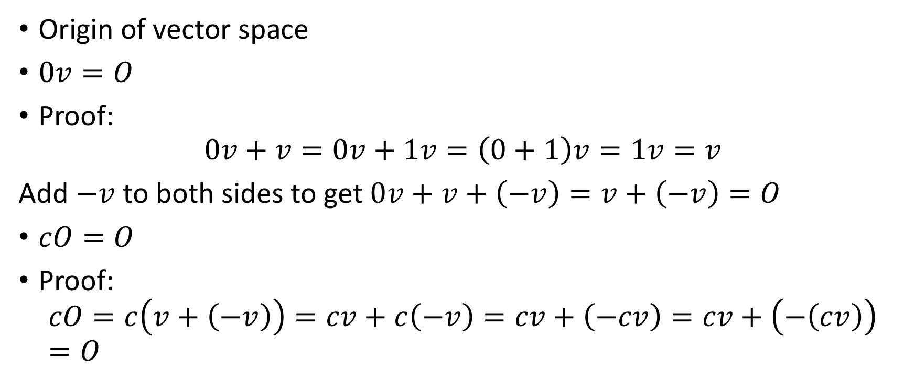
Example
Origin of vector space
$0v=O$
Proof:
$$0v+v=0v+1v=\left(0+1\right)v=1v=v$$
Add $−v$ to both sides to get $0v+v+\left(−v\right)=v+\left(−v\right)=O$
$cO=O$
Proof:
$$cO=c\left(v+\left(−v\right)\right)=cv+c\left(−v\right)=cv+\left(−cv\right)=cv+\left(−\left(cv\right)\right)=O$$

Slide 5
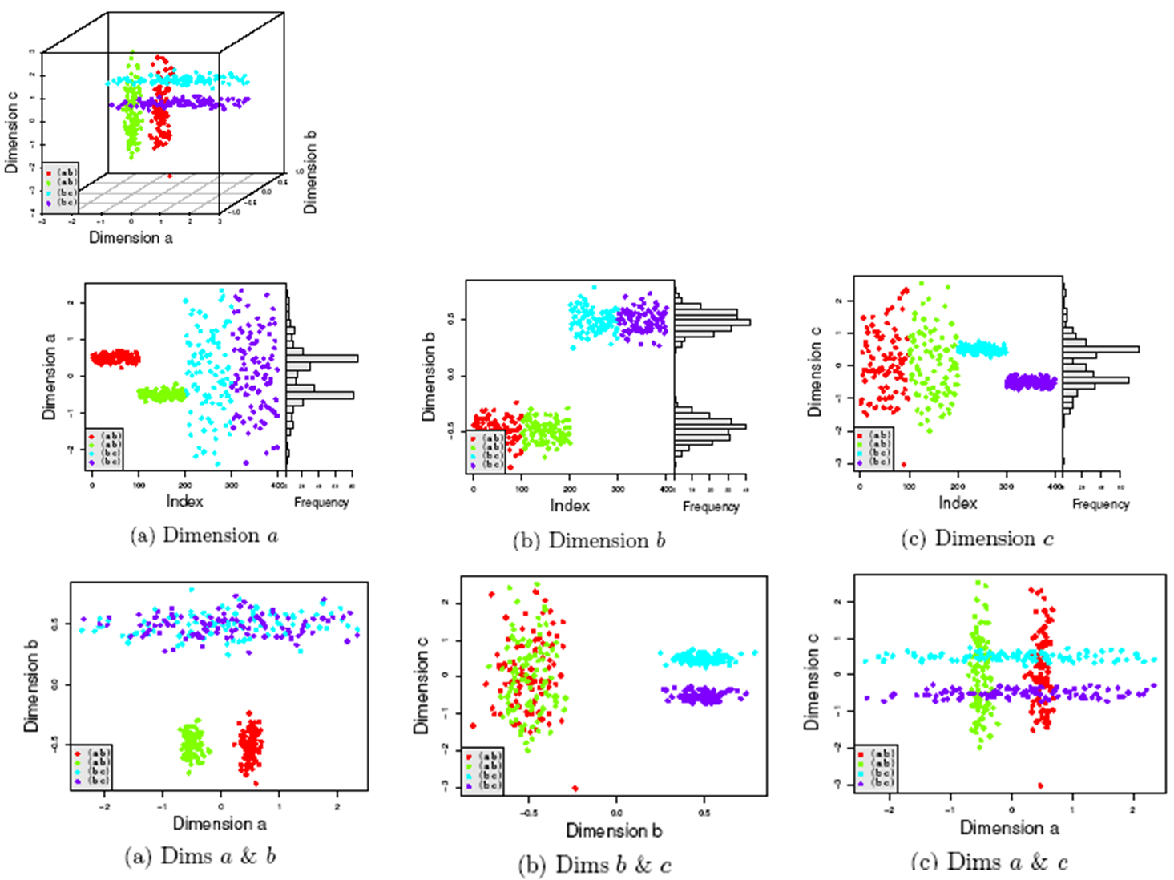
Subspaces

Slide 6
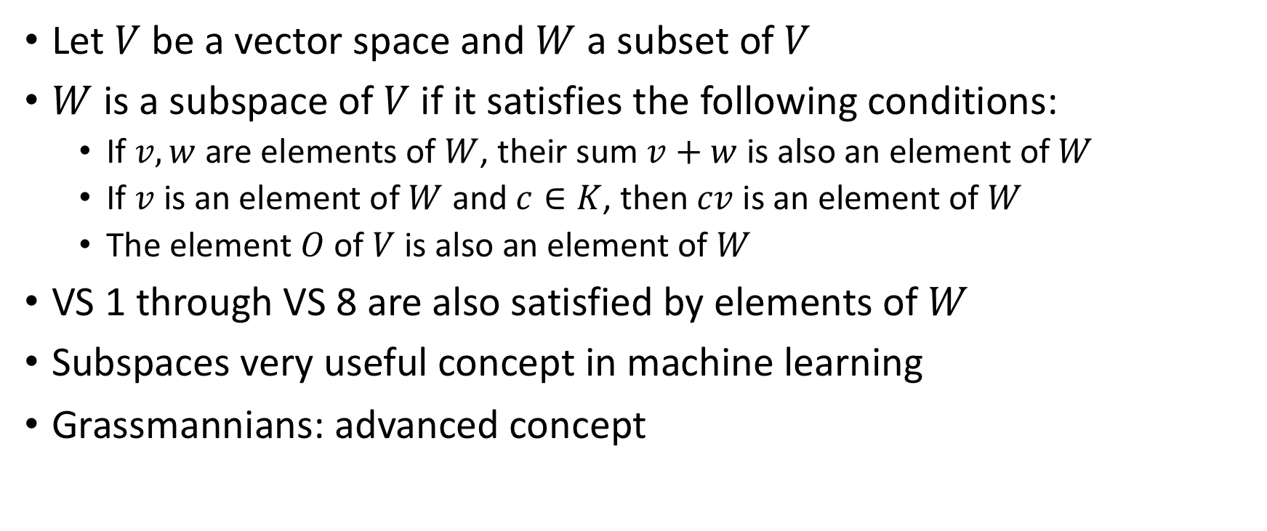
Introduction to Subspaces
Let $V$ be a vector space and $W$ a subset of $V$
$W$ is a subspace of $V$ if it satisfies the following conditions:
If $v,w$ are elements of $W$, their sum $v+w$ is also an element of $W$
If $v$ is an element of $W$ and $c∈K$, then $cv$ is an element of $W$
The element $O$ of $V$ is also an element of $W$
VS 1 through VS 8 are also satisfied by elements of $W$
Subspaces very useful concept in machine learning
Grassmannians: advanced concept

Slide 7
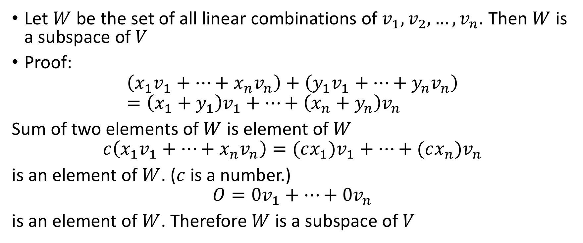
Linear Combinations
Let $W$ be the set of all linear combinations of $v_{1},v_{2},…,v_{n}$. Then $W$ is a subspace of $V$
Proof:
$$\left(x_{1}v_{1}+…+x_{n}v_{n}\right)+\left(y_{1}v_{1}+…+y_{n}v_{n}\right)=\left(x_{1}+y_{1}\right)v_{1}+…+\left(x_{n}+y_{n}\right)v_{n}$$
Sum of two elements of $W$ is element of $W$
$$c\left(x_{1}v_{1}+…+x_{n}v_{n}\right)=(cx_{1})v_{1}+…+(cx_{n})v_{n}$$
is an element of $W$. ($c$ is a number.)
$$O=0v_{1}+…+0v_{n}$$
is an element of $W$. Therefore $W$ is a subspace of $V$

Slide 8
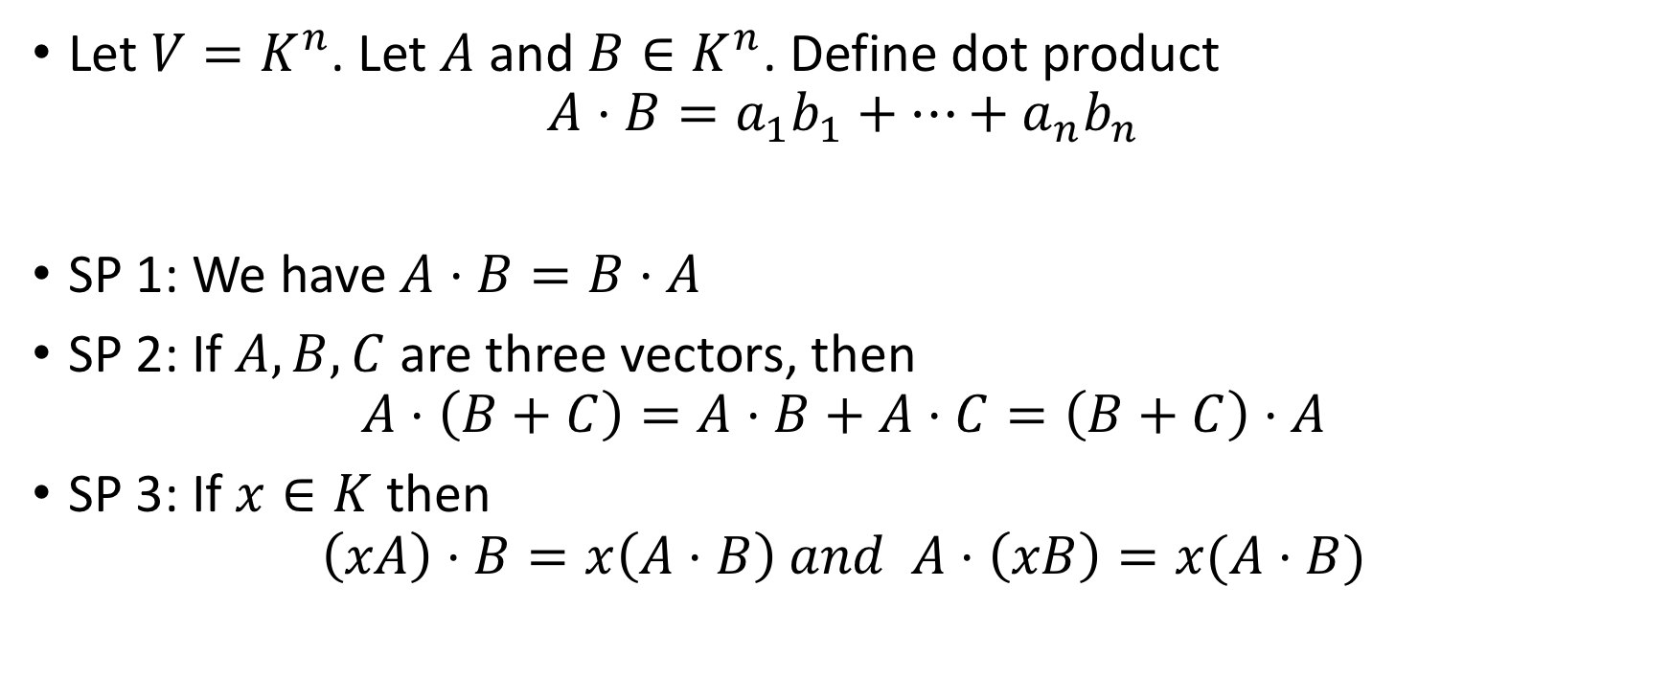
Example 3
Let $V=K^{n}$. Let $A$ and $B∈K^{n}$. Define dot product
$$A⋅B=a_{1}b_{1}+⋯+a_{n}b_{n}$$
SP 1: We have $A⋅B=B⋅A$
SP 2: If $A,B,C$ are three vectors, then
$$A⋅\left(B+C\right)=A⋅B+A⋅C=\left(B+C\right)⋅A$$
SP 3: If $x∈K$ then
$$\left(xA\right)⋅B=x\left(A⋅B\right) and A⋅\left(xB\right)=x(A⋅B)$$

Slide 9
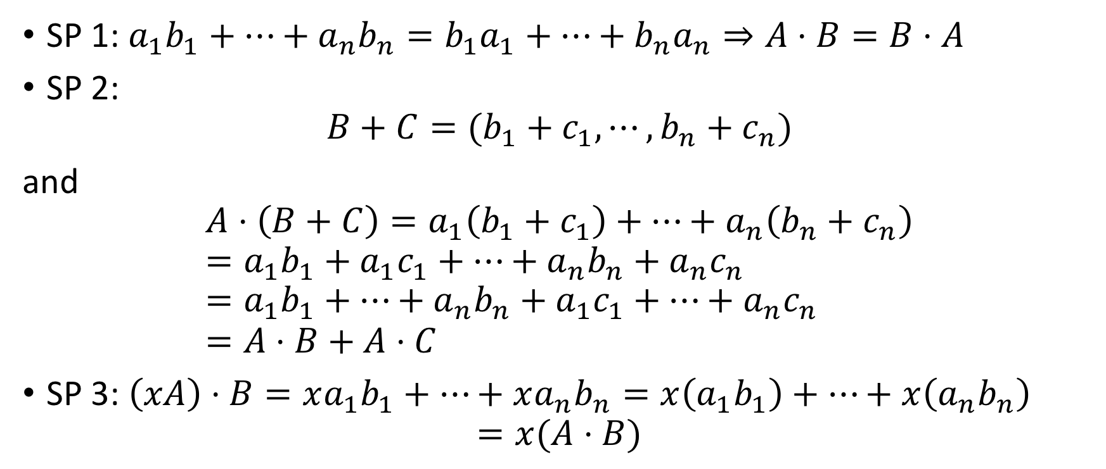
Example 3 (Proof)
SP 1: $a_{1}b_{1}+⋯+a_{n}b_{n}=b_{1}a_{1}+⋯+b_{n}a_{n}⇒A⋅B=B⋅A$
SP 2:
$$B+C=(b_{1}+c_{1},⋯,b_{n}+c_{n})$$
and
$$A⋅\left(B+C\right)=a_{1}\left(b_{1}+c_{1}\right)+⋯+a_{n}\left(b_{n}+c_{n}\right) \\ =a_{1}b_{1}+a_{1}c_{1}+⋯+a_{n}b_{n}+a_{n}c_{n} \\ =a_{1}b_{1}+⋯+a_{n}b_{n}+a_{1}c_{1}+⋯+a_{n}c_{n} \\ =A⋅B+A⋅C$$
SP 3: $\left(xA\right)⋅B=xa_{1}b_{1}+⋯+xa_{n}b_{n}=x\left(a_{1}b_{1}\right)+⋯+x\left(a_{n}b_{n}\right)$ $=x(A⋅B)$

Slide 10
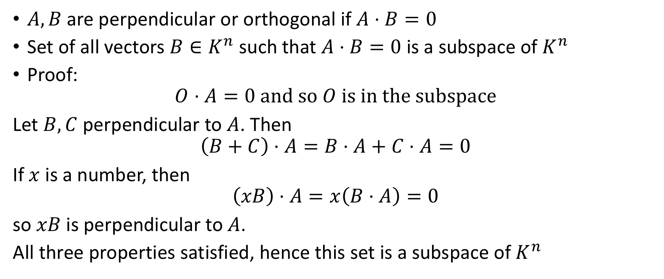
Perpendicular or Orthogonal Vectors
$A,B$ are perpendicular or orthogonal if $A⋅B=0$
Set of all vectors $B∈K^{n}$ such that $A⋅B=0$ is a subspace of $K^{n}$
Proof:
$$O⋅A=0 and so O is in the subspace$$
Let $B,C$ perpendicular to $A$. Then
$$\left(B+C\right)⋅A=B⋅A+C⋅A=0$$
If $x$ is a number, then
$$\left(xB\right)⋅A=x\left(B⋅A\right)=0$$
so $xB$ is perpendicular to $A$.
All three properties satisfied, hence this set is a subspace of $K^{n}$

Slide 11
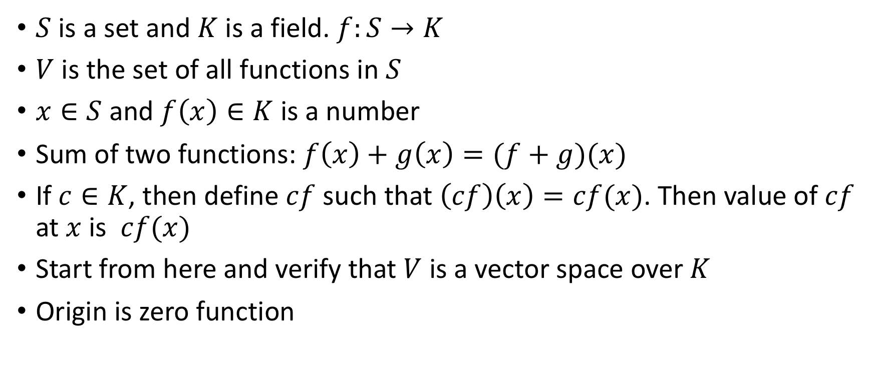
Example 4: Function Spaces
$S$ is a set and $K$ is a field. $f:S→K$
$V$ is the set of all functions in $S$
$x∈S$ and $f\left(x\right)∈K$ is a number
Sum of two functions: $f\left(x\right)+g\left(x\right)=(f+g)(x)$
If $c∈K$, then define $cf$ such that $\left(cf\right)\left(x\right)=cf(x)$. Then value of $cf$ at $x$ is $cf(x)$
Start from here and verify that $V$ is a vector space over $K$
Origin is zero function

Slide 12
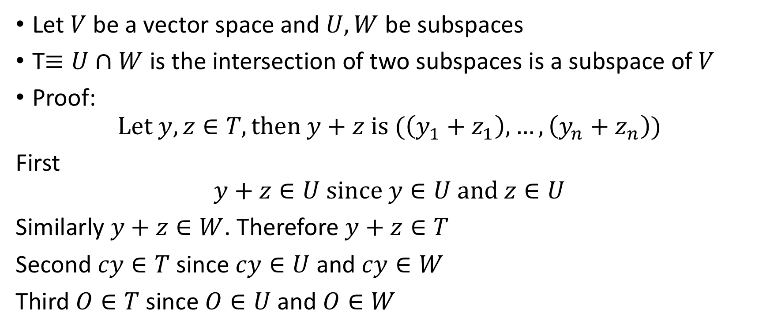
Example 5
Let $V$ be a vector space and $U,W$ be subspaces
T$≡U∩W$ is the intersection of two subspaces is a subspace of $V$
Proof:
$$Let y,z∈T, then y+z is (\left(y_{1}+z_{1}\right),…,\left(y_{n}+z_{n}\right))$$
First
$$y+z∈U since y∈U and z∈U$$
Similarly $y+z∈W$. Therefore $y+z∈T$
Second $cy∈T$ since $cy∈U$ and $cy∈W$
Third $O∈T$ since $O∈U$ and $O∈W$

Slide 13
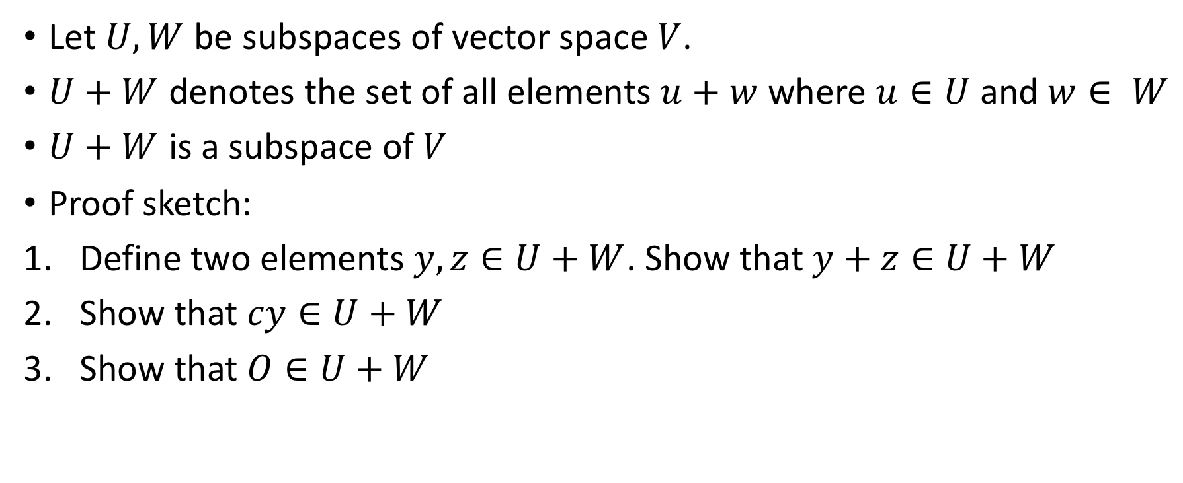
Example 6
Let $U,W$ be subspaces of vector space $V$.
$U+W$ denotes the set of all elements $u+w$ where $u∈U$ and $w∈ W$
$U+W$ is a subspace of $V$
Proof sketch:
Define two elements $y,z∈U+W$. Show that $y+z∈U+W$
Show that $cy∈U+W$
Show that $O∈U+W$

